Slide 1
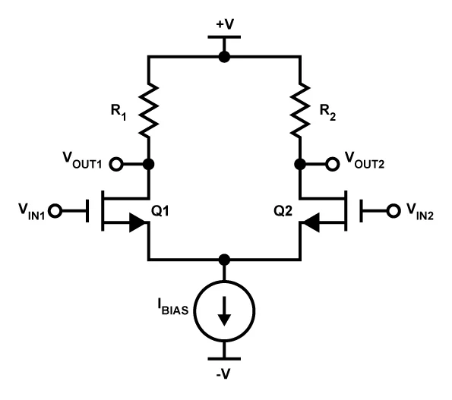
Differential Amplifiers

Slide 2
Common-Mode and Differential-Mode Signals & Gain

Slide 3
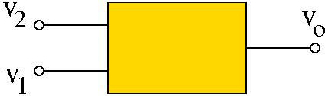
Differential and Common-Mode Signals/Gain
Consider a linear circuit
with TWO inputs
By superposition:
v_{o} = A₁ ⋅ v₁ + A₂ ⋅ v₂
v_{d} = v₂ − v₁
v
Define:
Difference (or differential) Mode
v₁ = v_{c} −
d
2
v_{d}
v + v
v =
1
2
Common Mode
c
2
v₂ = v_{c} +
2
v_{d}
v_{d}
Substituting for v₁ = v_{c} − ₂
and v₂ = v_{c} + ₂
in the expression for v_{o}:
v
⎞
⎛
v
⎞
= (A₁ + A₂ )⋅ v_{c} +
⎛
A₂ − A₁
⎞
v = A ⋅⎛ v −
d
A ⋅ v +
d
⋅ v
⎜ ₂ ⎟
⎜
₂ ⎟
⎜
⎟
o 1
⎝
c
⎠
2
⎝
c
⎠
⎝
2
⎠
d
v_{o} = A_{c} ⋅ v_{c} + A_{d} ⋅ v_{d}

Slide 4
Differential and common-mode signal/gain is an alternative way of finding the system response
v_{d} = v₂ − v₁
A_{c} = A₁ + A₂
₌ A₂ − A₁
2
v + v
v =
1 2
A
c
2
d
v_{o} = A₁ ⋅ v₁ + A₂ ⋅ v₂
v_{o} = A_{c} ⋅ v_{c} + A_{d} ⋅ v_{d}
v
A
v₁ = v_{c} −
d
A =
c
A
2
1
2
d
v
A
v₂ = v_{c} +
d
A =
c
A
2
d
2 2
Differential Gain: Common Mode Gain:
Common Mode Rejection Ratio (CMRR)*:
A_{d} A_{c}
|A_{d}|/|A_{c}|
* CMRR is usually given in dB: CMRR(dB) = 20 log (|A_{d}|/|A_{c}|)

Slide 5
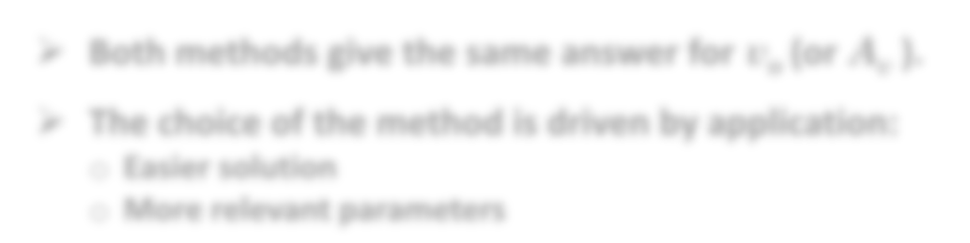

To find v_{o} ,we can calculate/measure either A₁ A₂ pair or A_{c} A_{d} pair
Superposition (finding A₁ and A₂ ):
Set v₂ = 0, compute A₁ from
v_{o} = A₁ v₁
Set v₁ = 0, compute A₂ from
v_{o} = A₂ v₂
For any v₁ and v₂ :
v_{o} = A₁ v₁ + A₂ v₂
Difference Method (finding A_{d} and A_{c} ):
1. Set v_{c} = 0 (or set v₁ = − 0.5 v_{d} & v₂ = + 0.5 v_{d}) compute A_{d} from v_{o} = A_{d} v_{d}
Set v_{d} = 0 (or set v₁ = + v_{c} & v₂ = + v_{c} ) compute A_{c} from v_{o} = A_{c} v_{c}
For any v₁ and v₂ : v_{o} = A_{d} v_{d} + A_{c} v_{c}
v_{d} = v₂ − v₁ v_{c} = 0.5(v₁ + v₂ )
Both methods give the same answer for v_{o} (or A_{v} ).
The choice of the method is driven by application:
Easier solution
More relevant parameters

Slide 6
Why are Differential Amplifiers popular?
They are much less sensitive to noise (CMRR >>1).

Slide 7
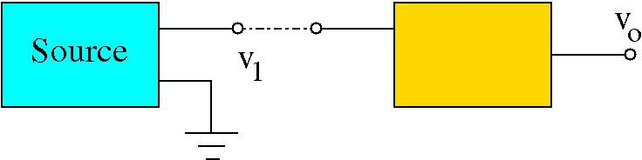
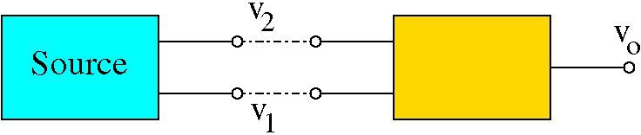
Why is a large CMRR useful?
A major goal in circuit design is to minimize the noise level (or improve signal-to-noise ratio). Noise comes from many sources (thermal, EM, …)
A regular amplifier “amplifies” both signal and noise.
^{v}1 ^{= v}sig ^{+ v}noise
v_{o} = A ⋅ v₁ = A ⋅ v_{sig} + A ⋅ v_{noise}
However, if the signal is applied between two inputs and we use a difference amplifier with a large CMRR, the signal is amplified a lot more than the noise which improves the signal to noise ratio.*
v₁ = −0.5v_{sig} + v_{noise} & v₂ = +0.5v_{sig} + v_{noise}
v_{d} = v₂ − v₁ = v_{sig}
^{& v}c ^{= v}noise
A_{d} CMRR
v_{o} = A_{d} ⋅ v_{d} + A_{c} ⋅ v_{c} = A_{d} ⋅ v_{sig} +
⋅ v
noise
* Assuming that noise levels are similar to both inputs.

Slide 8
BJT Differential Amplifier
In addition to common emitter, common-collector (i.e., the emitter follower), and common-base amplifiers, a fourth important and “classic” BJT amplifier stage is the differential pair.

Slide 9


Differential Amplifiers
$$I_{C}=I_{S}\exp{\frac{V_{BE}}{V_{T}}}$$
$$I_{C}={αI}_{E}$$

Slide 10
Differential Amplifiers
DC current
AC current

Slide 11
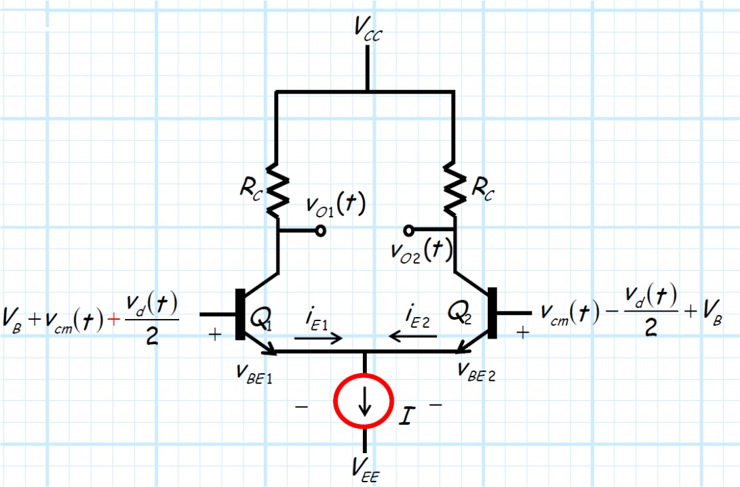
Now lets consider the case where each input of the differential pair consists of an identical DC bias term V_{B}, and also an AC small-signal component (i.e., v₁(t) and v₂(t))

Slide 12
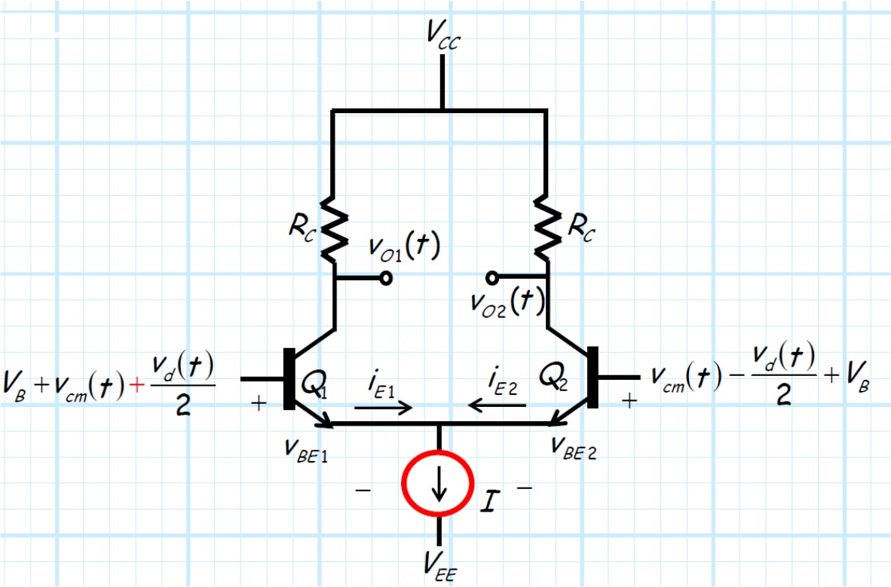

Slide 13
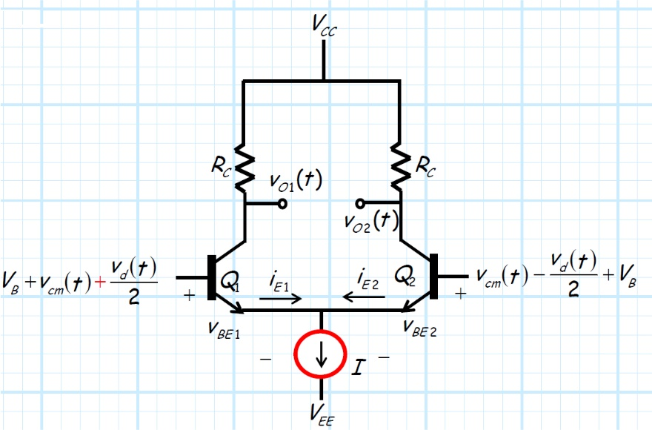

Slide 14
How do we analyze this?
A: In a word, superposition!

Slide 19
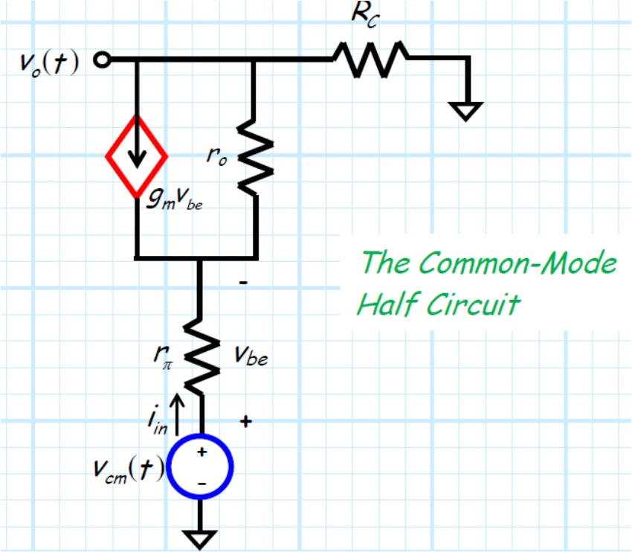
If we do not neglect r_{o} resistance will be almost zero.

Slide 20
We then turn off the two common-mode sources, and analyze the circuit with only the two (equal but opposite valued) differential-mode sources.

Slide 24
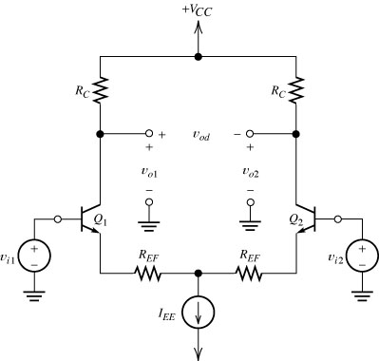
Emitter degeneration
Sometimes it is advantageous to add emitter generation resistor REF to the circuit, as shown in the Figure.
There resistors have the disadvantage of reducing the differential voltage gain of the circuit. However, two reasons for this is to increase input impedance and to reduce distortion due to the nonlinearity of the BJTs.

Slide 25
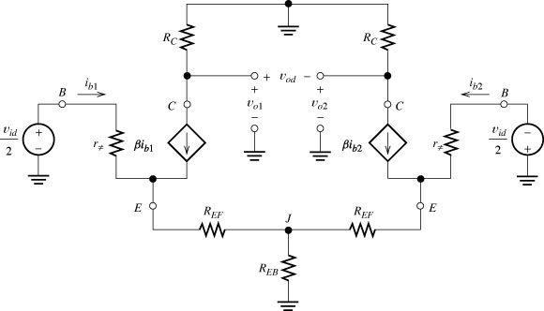
Small-signal analysis of the Emitter-coupled differential pair.
Using small-signal analysis, we can derive expressions for voltage gain, input impedance and output impedance of the emitter-coupled differential pair.
The small-signal equivalent circuit for the differential pair is shown below by replacing the transistors by their small-signal models.
Note that power supply has been shorted to GND in small-signal circuit.
Also note that the IEE current source is replaced by a resistance REB in the small-signal circuit, as practical current sources has a finite output impedance.

Slide 26
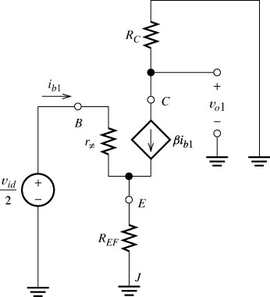
Small-signal analysis: differential input
First, we analyze the circuit for a pure differential input signal. Therefore the input voltage are v_{i1}=-v_{i2}=v_{id}/2.
The analysis can be simplified by observing that the equivalent circuit is symmetrical. Due to this symmetry and opposite polarity of the independent sources, the voltage at point J is zero. The circuit behavior would not change by shorting point J to Ground.
We can then consider only the left-hand side circuit as shown in the Figure. We need to analyze only this half circuit as the right half is the same except different polarity.
Figure 7.34 Half-circuit for a differential input signal.

Slide 27
Small-signal analysis: differential input II
The voltage gain is:
Figure 7.34 Half-circuit for a differential input signal.

Slide 28
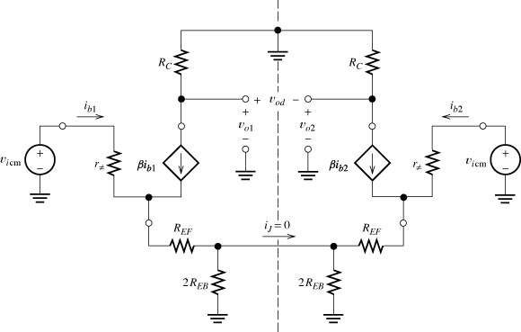
Small-signal analysis: common-mode input,
When the input voltage are v_{i1}=v_{i2}=v_{icm}, the equivalent circuit is depicted in the figure. We have shown the output impedance of the current source as the parallel combination of two resistors.
The equivalent circuit is symmetrical with respect to the dashed line including the polarities of the signal sources. Therefore, we conclude that current iJ must be zero.
As such, we can open the connection and consider only left or right hand half circuit.
Figure 7.35 Small-signal equivalent circuit with a pure common-mode input signal.

Slide 29
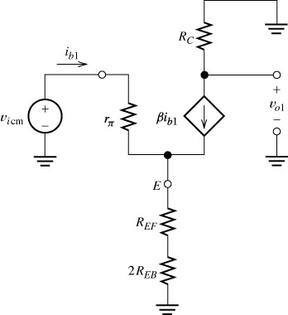
Small-signal analysis: common-mode input
Note that we have defined the common-mode input impedance to be the voltage divided by the total current the source must deliver to both terminals.
The gain from a single-ended load to common-mode input is:
As v_{o1}=v_{o2}=v_{ocm}
Figure 7.36 Half-circuit for a pure common-mode input signal.

